Slide 1
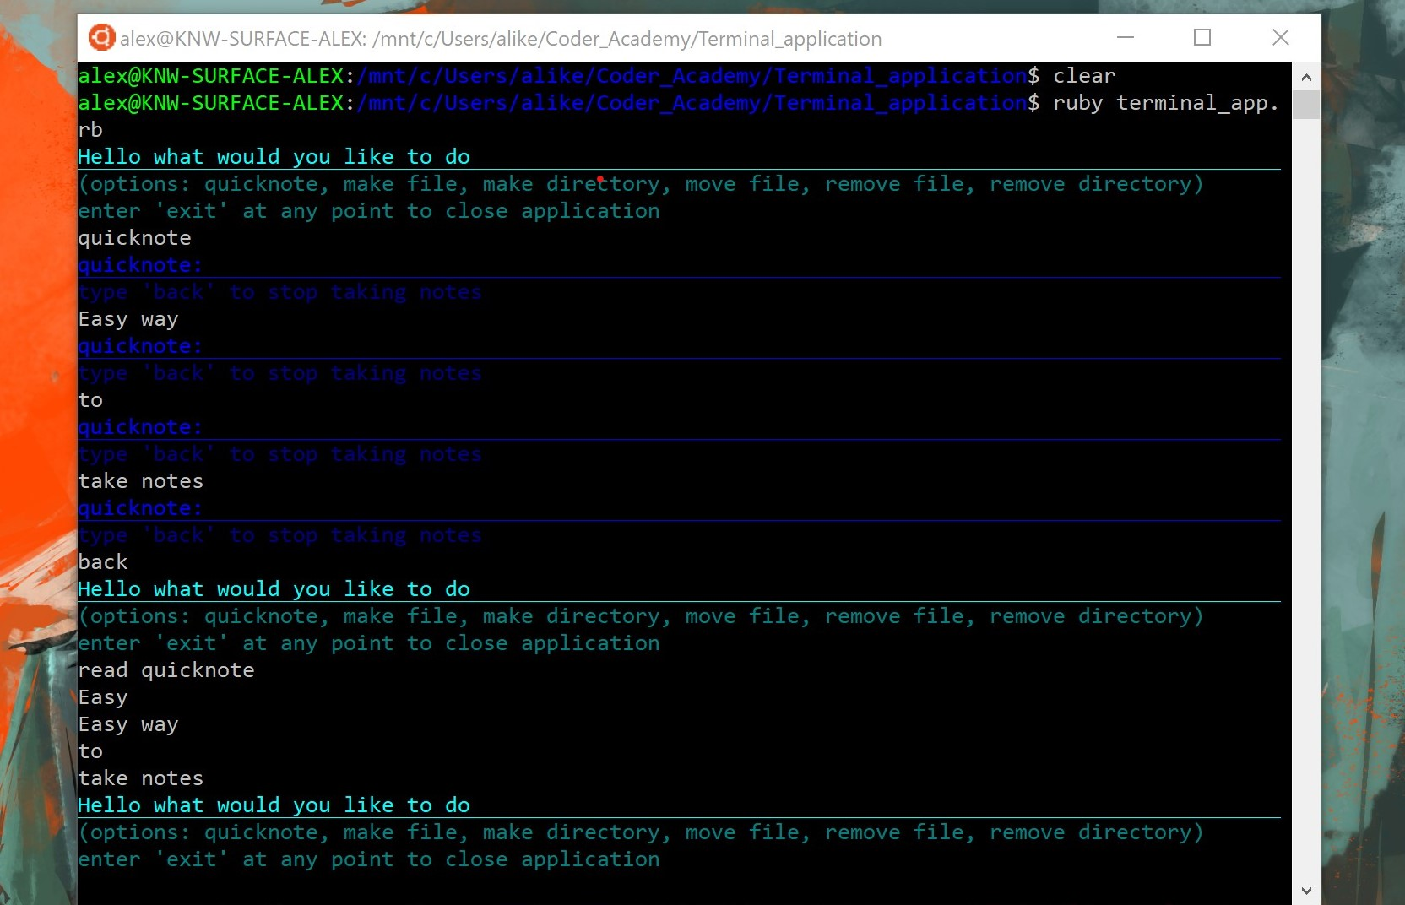
Alex’s Note taking App
Hope you enjoy

Slide 2
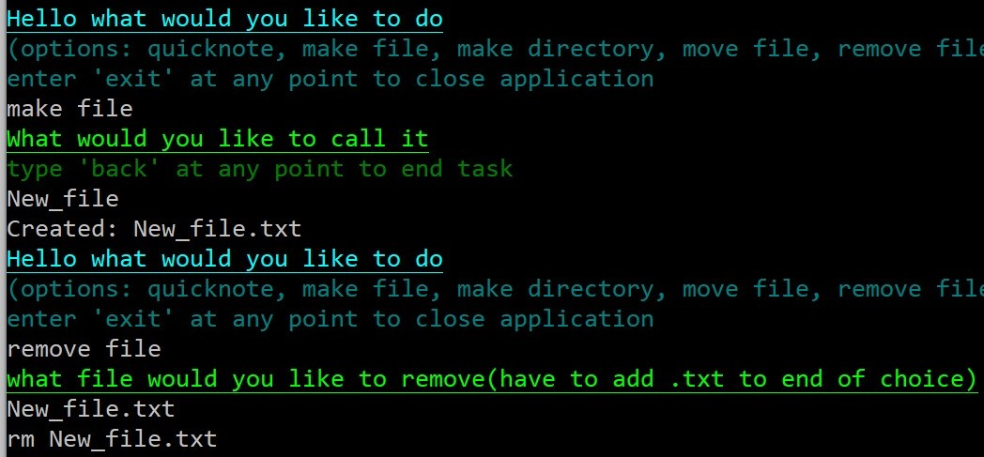
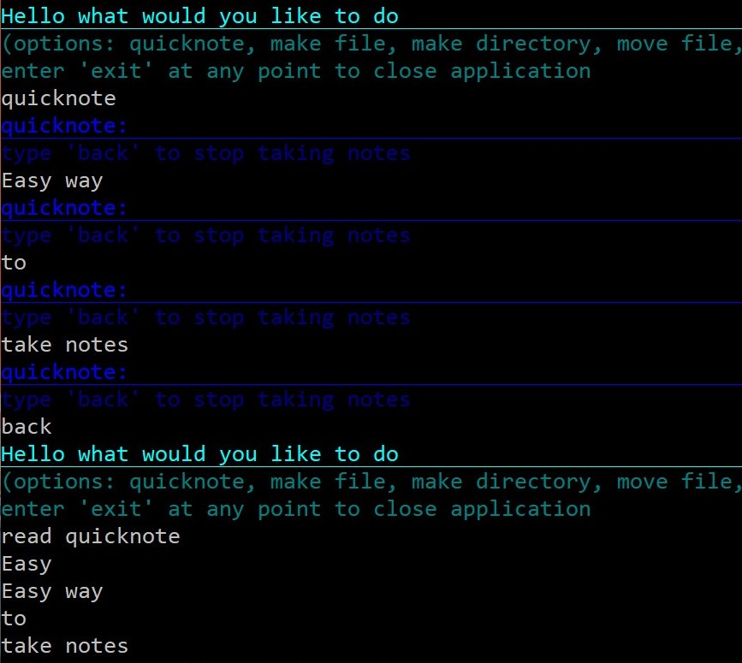
What it does?
Easily create and access notes from terminal
Make and remove files/directories
Move files where you want
Take quicknotes directly in the terminal
Print those notes to the terminal to check your work

Slide 3
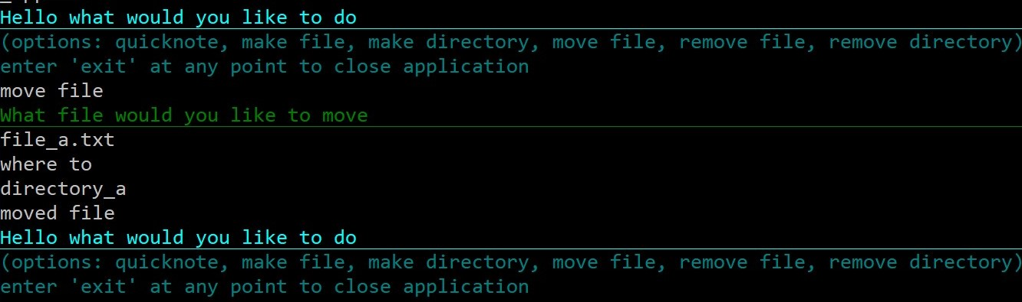
Why is it needed?
Easy way to make a quick side note for developers that spend a lot of their time in the terminal
Simplifies how you keep your notes
Ease of file/folder creation and handling, e.g. the ‘move file’ command.

